Slide 1
Taking out all the stops Arlene Hackbarth, LCPC
Using multiple interventions to empower and engage people who are homeless

Slide 2
learning objectives
Learn how to change the culture in treatment programs to partner with the persons served
Learn how to maximize the time spent with people who are homeless to promote empowerment and healing
Learn interventions to help persons who are homeless regain purpose and value

Slide 3
Part 1- using trauma -informed principles to change culture

Slide 4
Difficulties Encountered Within Systems of Care
Re-traumatization: Lack of respect and safety and an absence of control and choice that mimics past traumatic experiences.

Slide 5
Trauma-Informed Services
“At minimum, trauma-informed services should endeavor to do no harm...”
Jahn Moses, D., Glover Reed, B., Mazelis, R., & D’Ambrosio, B. (2003). Creating trauma services for women with co-occurring disorders: Experiences from the SAMHSA women with alcohol, drug abuse and mental health disorders who have histories of violence study. Delmar, NY: Policy Research Associates (Women and Violence Coordinating Center).

Slide 6
Transformation at Every Level (SAMHSA)
System
Your Organization
You

Slide 7
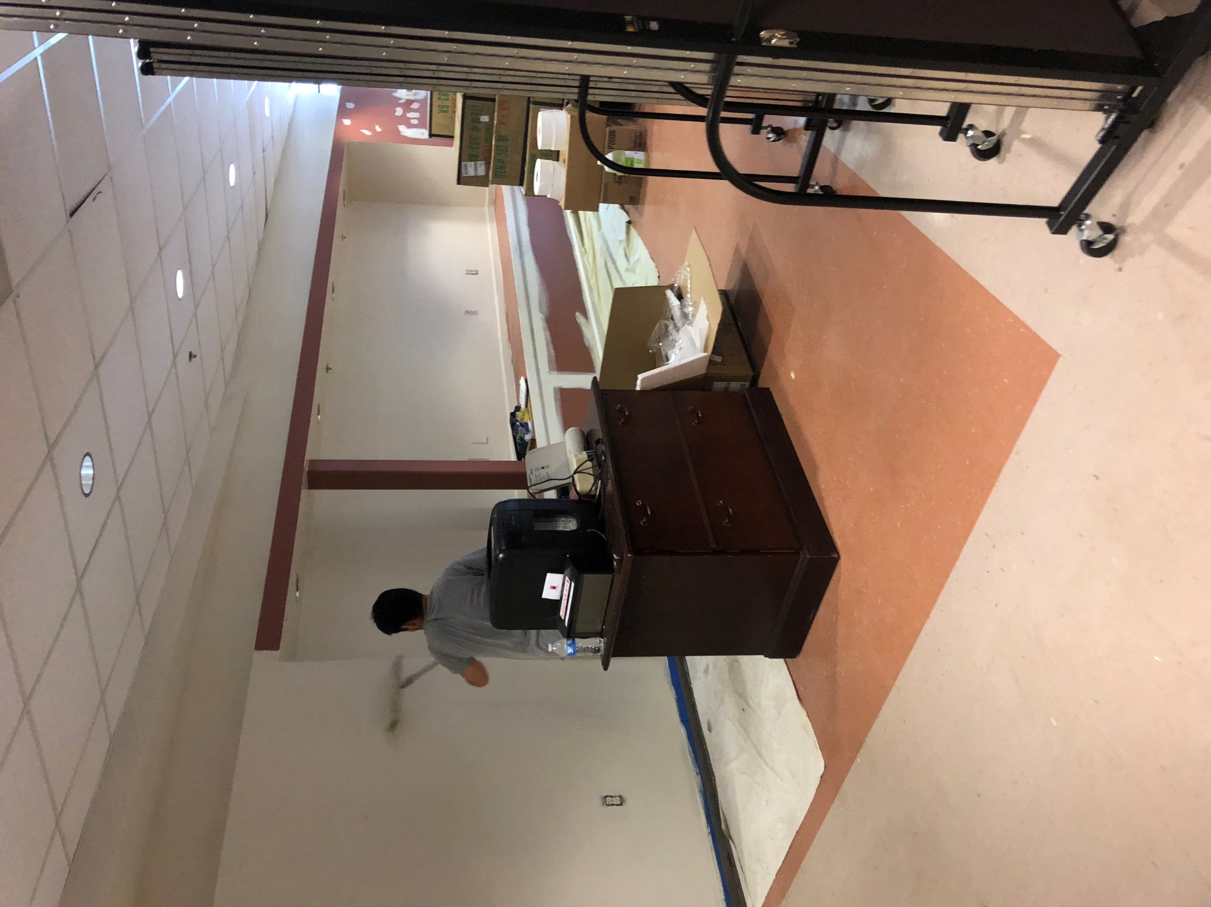
THE ENVIRONMENT
Is your program welcoming ?
Does it present as a safe space ?

Slide 8
Comparing Approaches
Traditional Approaches
Problems/Symptoms are discrete and separate.
Hierarchical.
Client behavior is viewed as “manipulative” or “working the system.”
Trauma-informed
Problems/Symptoms are inter-related responses to or coping mechanisms to deal with trauma.
Shares power/Decreases hierarchy.
Client behaviors are viewed as adaptations/ways to get needs met.
Adapted from L. Prescott

Slide 9
Comparing Approaches
Traditional Approaches
People providing shelter and services are the experts.
Primary goals are defined by service providers and focus on symptom reduction.
Reactive – services and symptoms are crisis driven and focused on minimizing liability.
Sees clients as broken, vulnerable and needing protection from themselves.
Trauma-informed
Homeless families are active experts and partners with service providers.
Primary goals are defined by homeless families and focus on recovery, self-efficacy, and healing.
Proactive – preventing further crisis and avoiding retraumatization.
Understands providing choice, autonomy and control is central to healing.
Adapted from L.Prescott

Slide 10
The moment a person walks in the door
they are welcomed to our facility
They are offered food and something to drink
They are offered to take a shower
They participate with staff in the searches of their belongings
These take place before the men are asked to meet with a case manager to do intakes or fill out any paperwork

Slide 11
Support Client Control, Choice & Autonomy
Trauma survivors feel powerless.
Recovery requires a sense of power and control.
Relationships should be respectful and support mastery.
Clients should be encouraged to make choices.

Slide 12
How do we give a voice?
Their words, not ours, on all treatment plans
“ I want to live near a lake “
“I want a job working with my hands”
“I want to reunite with my daughter “

Slide 13
Giving a voice
the suggestion box

Slide 14
surveys
BY ASKING THE VETERANS THEIR OPINIONS:
THEY FEEL VALUED
YOUR PROGRAM CAN BE ASSURED OF CONTINUING FEEDBACK FOR IMPROVEMENTS
This Photo by Unknown Author is licensed under CC BY

Slide 15
committees
Involve the veterans in as many decisions as possible :
Some examples :
The veterans planned their holiday events
The veterans planned their trips

Slide 16
GREIVANCE PROCEDURE
POST A GRIEVANCE PROCEDURE SO THE VETERANS KNOW HOW TO PROPERLY REGISTER A COMPLAINT
This Photo by Unknown Author is licensed under CC BY

Slide 17
Part 2: expanding experiences TO PROMOTE EMPOWERMENT AND HEALING
TRANSFERABLE EXPERIENCES THAT UPLIFT

Slide 18
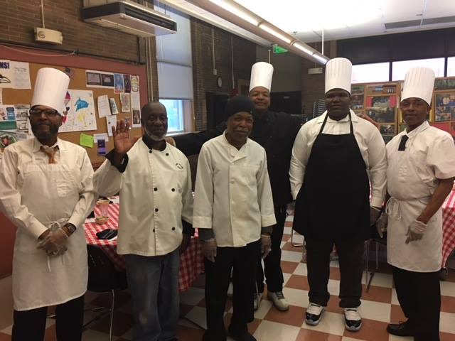
FORMAL DINNER

Slide 19
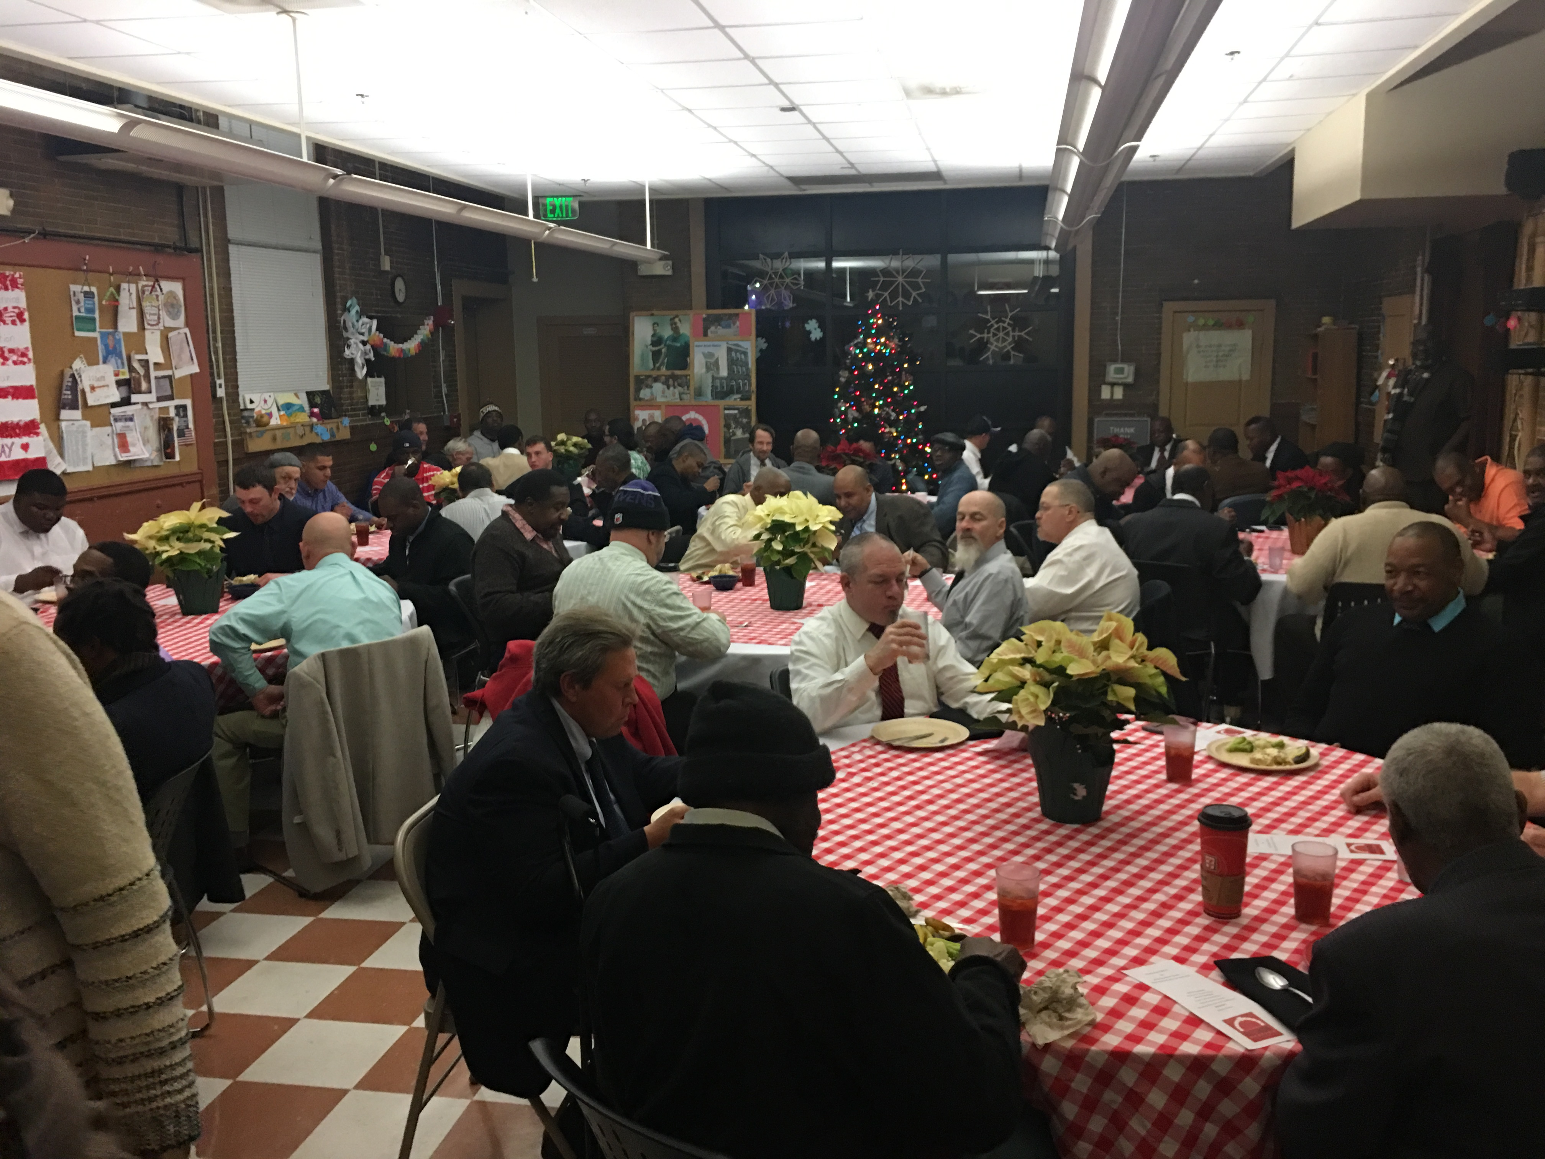
“WE WANT THE CHANCE TO DRESS UP”
Local barbers offer free haircuts
Local restaurants come and cook
Men are offered shirts and ties
Staff and board members serve

Slide 20
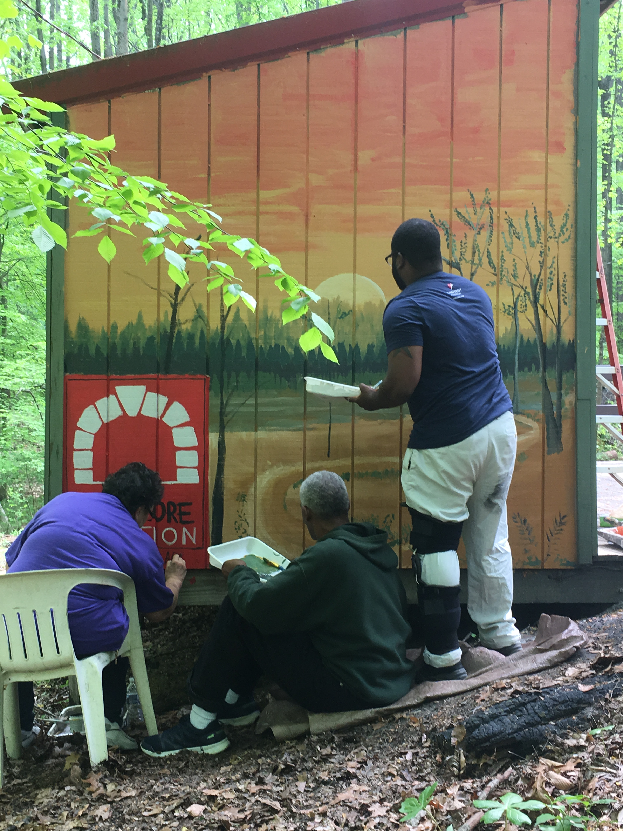
“where there are no corners”

Slide 21
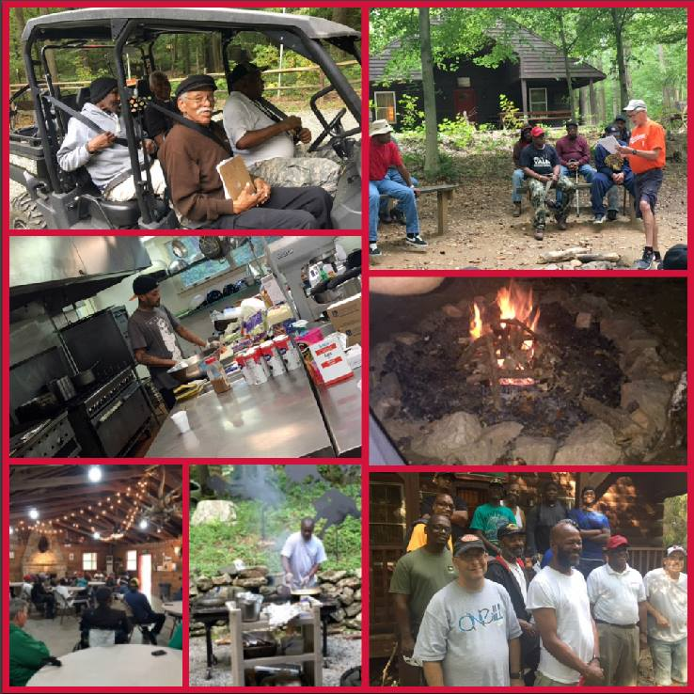

Slide 22
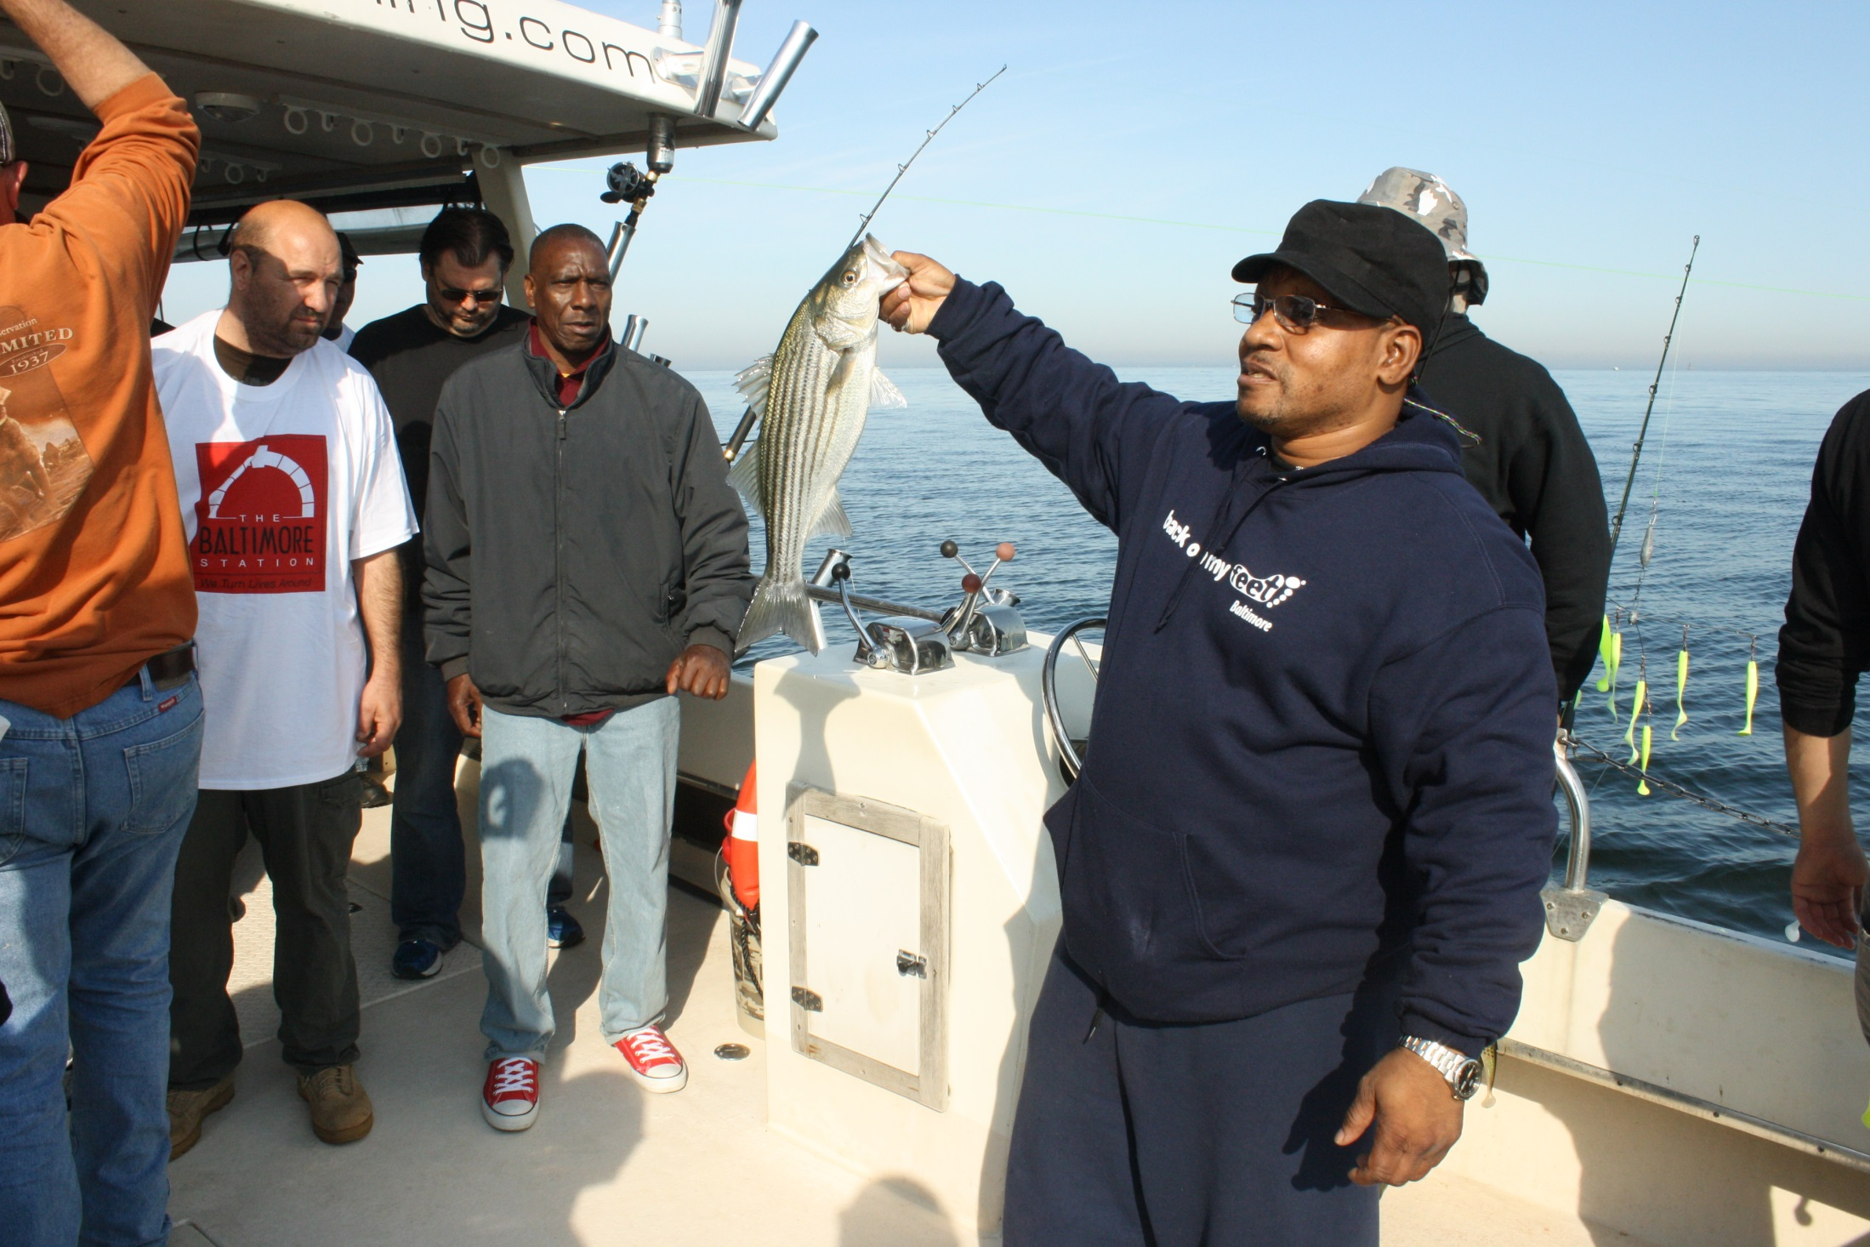
Fishing: teaches self reliance and bestows patience

Slide 24
Experiences that inspire
Washington D.C
Gettysburg
Professional sports games
Theater
“ I am learning that I do not need a lot of money to take trips with friends and family “
“ I am learning new interests and ways to enjoy myself “

Slide 25
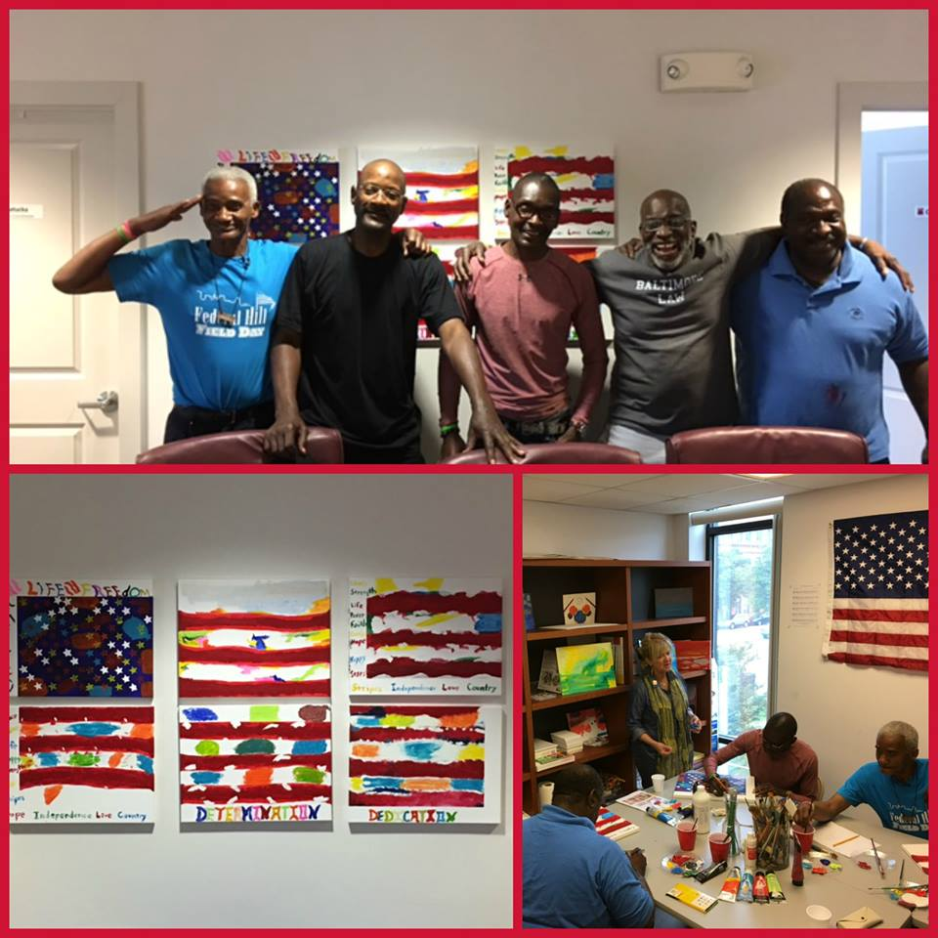
Classes at the Baltimore Station- Inspired by the residents
Classes geared towards self expression :
Art
Drama
Legacy letters

Slide 26
Classes to lower levels of depression, stress, and anxiety
Tai chi
Mindfullness
Music

Slide 27
Classes that assist with daily living
Cooking classes
Financial literacy
Diabetes education

Slide 28
Work therapy
Giving the men that chance to “practice “ work skills in our program
Consistent feedback
Gives a snapshot of strong work skills and those needing improvement
Allows the men to take ownership of the program

Slide 29
Part 3 : Interventions to help persons who are homeless regain purpose and value
Giving and gratitude

Slide 30
Reinforcing value
Volunteering
Donating at Christmas
Escorts

Slide 31
Gratitude
We know that gratitude :
Enhances empathy and reduces aggression
Improves self esteem
Increases mental strength
Fosters resilience
Encourage the veterans to write what they are grateful for daily .
Ask them everyday to relate some good news

Slide 32
Tashi Deley:
I honor the greatness that is within you

